Slide 1
Sorting in Data Structure

Slide 2
Bubble Sort
Bubble sort is a sorting algorithm that compares two adjacent elements and swaps them until they are in the intended order.
Working of Bubble Sort
Suppose we are trying to sort the elements in ascending order.

Slide 3
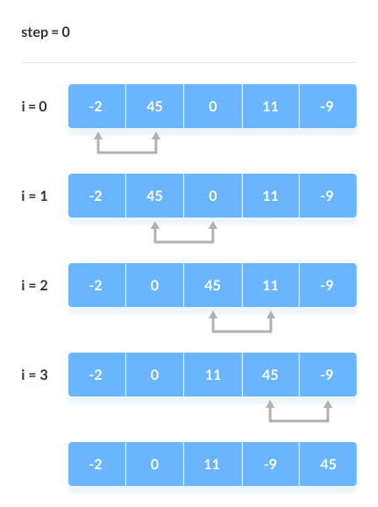
1. First Iteration (Compare and Swap)
Starting from the first index, compare the first and the second elements.
If the first element is greater than the second element, they are swapped.
Now, compare the second and the third elements. Swap them if they are not in order.
The above process goes on until the last element.

Slide 4
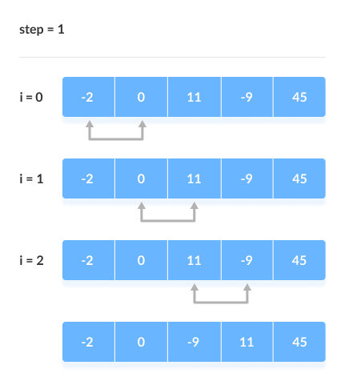
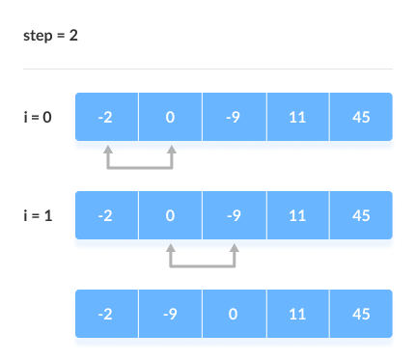
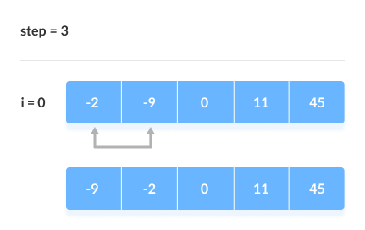
2. Remaining Iteration
The same process goes on for the remaining iterations.
After each iteration, the largest element among the unsorted elements is placed at the end.

Slide 5
Bubble Sort Algorithm
begin BubbleSort(arr)
for all array elements
if arr[i] > arr[i+1]
swap(arr[i], arr[i+1])
end if
end for
return arr
end BubbleSort

Slide 6
#include<iostream>
using namespace std;
void print(int a[], int n) //function to print array elements
{
int i;
for(i = 0; i < n; i++)
{
cout<<a[i]<<" ";
}
}
void bubble(int a[], int n) // function to implement bubble sort
{
int i, j, temp;
for(i = 0; i < n; i++)
{
for(j = i+1; j < n; j++)
{
if(a[j] < a[i])
{
temp = a[i];
a[i] = a[j];
a[j] = temp;
}
}
}
}

Slide 7
Bubble Sort Complexity
Time Complexity
Best | O(n)
Worst | O(n²)
Average | O(n²)
Space Complexity | O(1)
Bubble Sort Applications
Bubble sort is used if
complexity does not matter
short and simple code is preferred

Slide 8
Insertion Sort
Insertion sort is a sorting algorithm that places an unsorted element at its suitable place in each iteration.
Insertion sort works similarly as we sort cards in our hand in a card game.
We assume that the first card is already sorted then, we select an unsorted card. If the unsorted card is greater than the card in hand, it is placed on the right otherwise, to the left. In the same way, other unsorted cards are taken and put in their right place.
A similar approach is used by insertion sort.

Slide 9
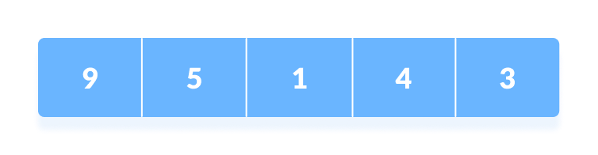
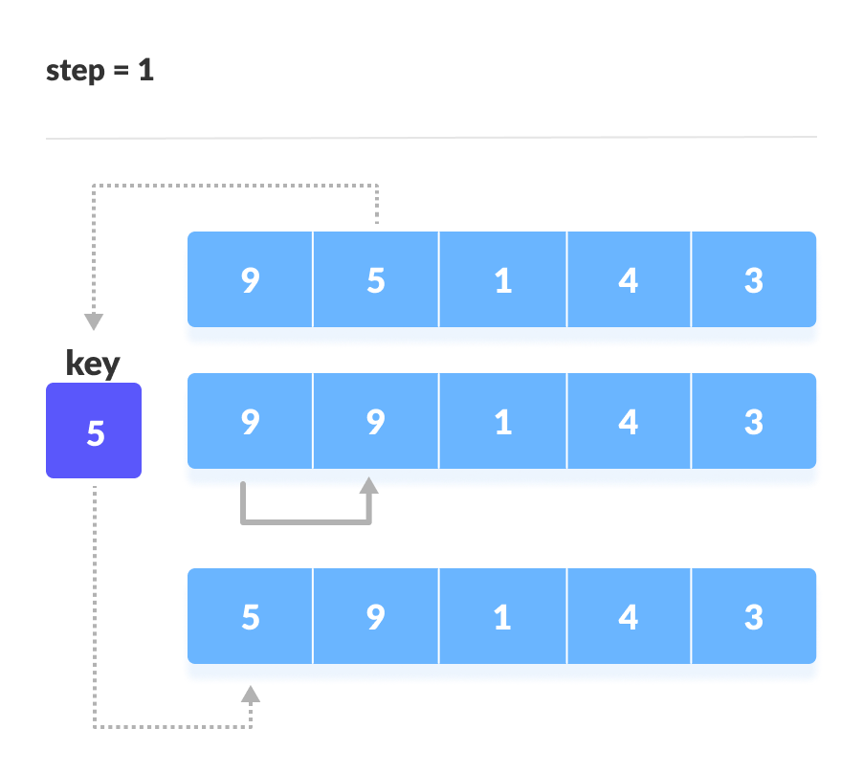
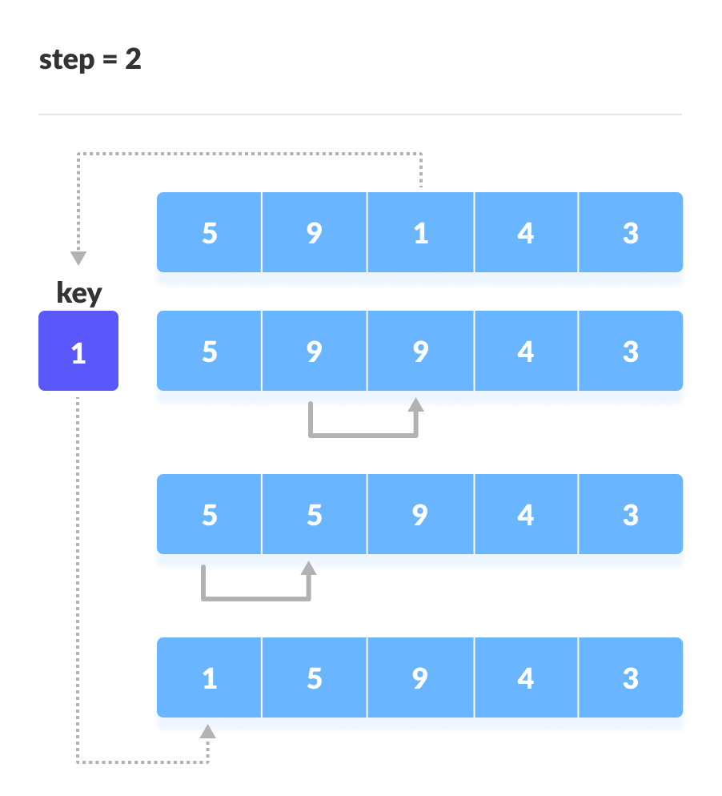

Working of Insertion Sort
The first element in the array is assumed to be sorted. Take the second element and store it separately in key. Compare key with the first element. If the first element is greater than key, then key is placed in front of the first element.

Slide 10
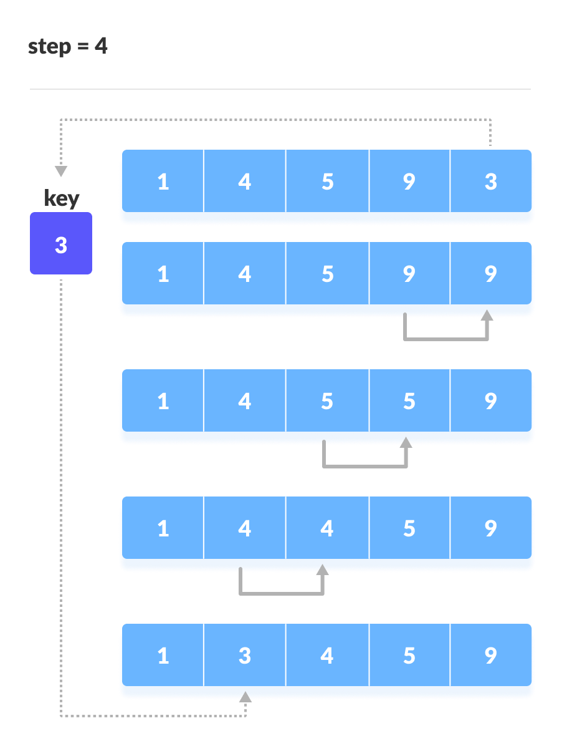

Slide 11
Algorithm
The simple steps of achieving the insertion sort are listed as follows -
Step 1 - If the element is the first element, assume that it is already sorted. Return 1.
Step2 - Pick the next element, and store it separately in a key.
Step3 - Now, compare the key with all elements in the sorted array.
Step 4 - If the element in the sorted array is smaller than the current element, then move to the next element. Else, shift greater elements in the array towards the right.
Step 5 - Insert the value.
Step 6 - Repeat until the array is sorted.

Slide 12
// Function to sort an array using
// insertion sort
void insertionSort(int arr[], int n)
{
int i, key, j;
for (i = 1; i < n; i++)
{
key = arr[i];
j = i - 1;
// Move elements of arr[0..i-1],
// that are greater than key, to one
// position ahead of their
// current position
while (j >= 0 && arr[j] > key)
{
arr[j + 1] = arr[j];
j = j - 1;
}
arr[j + 1] = key;
}
}
// A utility function to print an array
// of size n
void printArray(int arr[], int n)
{
int i;
for (i = 0; i < n; i++)
cout << arr[i] << " ";
cout << endl;
}

Slide 13
Insertion Sort Complexity
Time Complexity
Best | O(n)
Worst | O(n²)
Average | O(n²)
Space Complexity | O(1)
Stability | Yes
Insertion Sort Applications
The insertion sort is used when:
the array is has a small number of elements
there are only a few elements left to be sorted

Slide 14
Selection Sort Algorithm
Selection sort is a sorting algorithm that selects the smallest element from an unsorted list in each iteration and places that element at the beginning of the unsorted list.
In selection sort, the smallest value among the unsorted elements of the array is selected in every pass and inserted to its appropriate position into the array. It is also the simplest algorithm. It is an in-place comparison sorting algorithm. In this algorithm, the array is divided into two parts, first is sorted part, and another one is the unsorted part. Initially, the sorted part of the array is empty, and unsorted part is the given array. Sorted part is placed at the left, while the unsorted part is placed at the right.

Slide 15
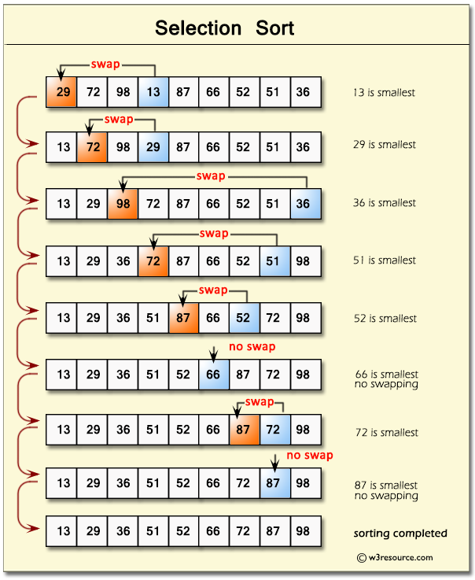
Selection sort is generally used when -
A small array is to be sorted
Swapping cost doesn't matter
It is compulsory to check all elements

Slide 16
SELECTION SORT(arr, n)
Step 1: Repeat Steps 2 and 3 for i = 0 to n-1
Step 2: CALL SMALLEST(arr, i, n, pos)
Step 3: SWAP arr[i] with arr[pos]
[END OF LOOP]
Step 4: EXIT
SMALLEST (arr, i, n, pos)
Step 1: [INITIALIZE] SET SMALL = arr[i]
Step 2: [INITIALIZE] SET pos = i
Step 3: Repeat for j = i+1 to n
if (SMALL > arr[j])
SET SMALL = arr[j]
SET pos = j
[END OF if]
[END OF LOOP]
Step 4: RETURN pos

Slide 17
void selection(int arr[], int n)
{
int i, j, small;
for(i=0;i<n-1; i++) // One by one move boundary of unsorted subarray
{
small = i; //minimum element in unsorted array
for (j = i+1; j < n; j++)
if (arr[j] < arr[small])
small = j;
// Swap the minimum element with the first element
int temp = arr[small];
arr[small] = arr[i];
arr[i] = temp;
}
}
void printArr(int a[], int n) /* function to print the array */
{
int i;
for (i = 0; i < n; i++)
printf("%d ", a[i]);
}

Slide 18
Selection Sort Complexity
Time Complexity
Best | O(n²)
Worst | O(n²)
Average | O(n²)
Space Complexity | O(1)
Stability | No
Selection Sort Applications
The selection sort is used when
a small list is to be sorted
cost of swapping does not matter
checking of all the elements is compulsory

Slide 19
Merge Sort Algorithm
Merge Sort is one of the most popular sorting algorithms that is based on the principle of Divide and Conquer Algorithm.
Here, a problem is divided into multiple sub-problems. Each sub-problem is solved individually. Finally, sub-problems are combined to form the final solution.
Divide
If q is the half-way point between p and r, then we can split the subarray A[p..r] into two arrays A[p..q] and A[q+1, r].
Conquer
In the conquer step, we try to sort both the subarrays A[p..q] and A[q+1, r]. If we haven't yet reached the base case, we again divide both these subarrays and try to sort them.
Combine
When the conquer step reaches the base step and we get two sorted subarrays A[p..q] and A[q+1, r] for array A[p..r], we combine the results by creating a sorted array A[p..r] from two sorted subarrays A[p..q] and A[q+1, r].

Slide 20
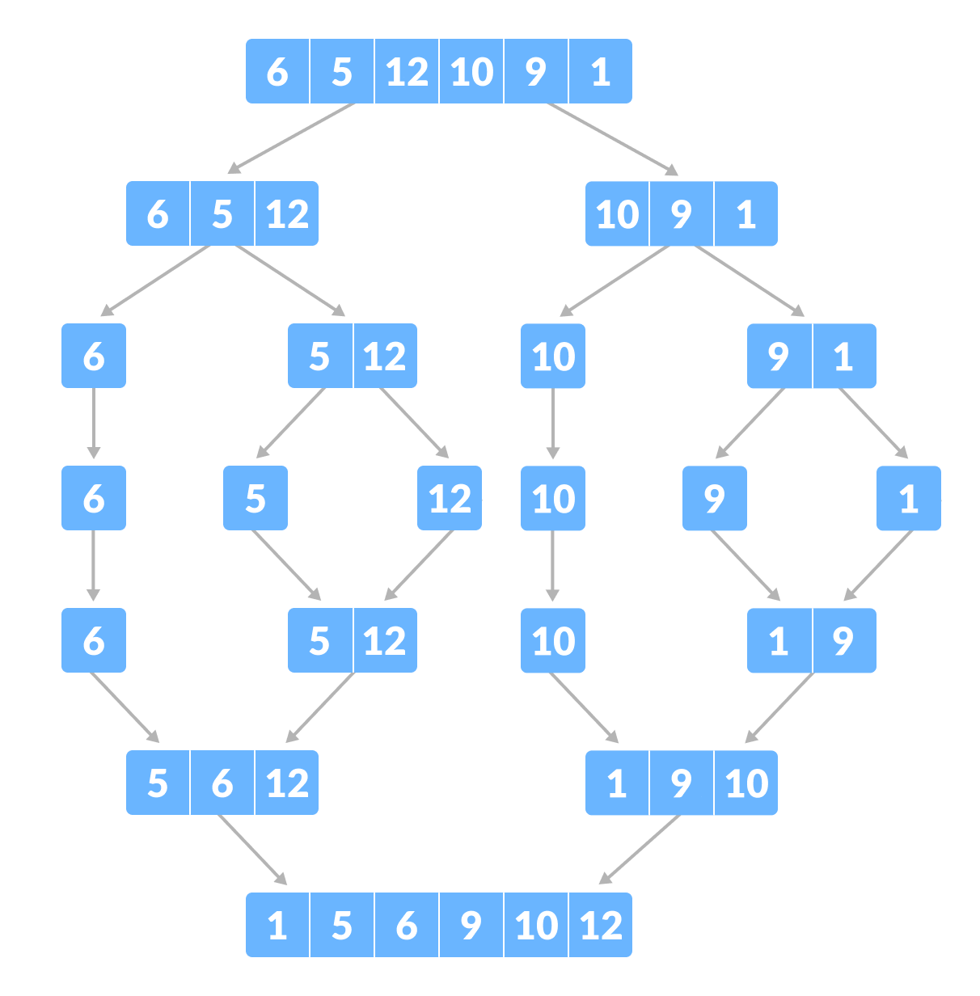

Slide 21
Algorithm
In the following algorithm, arr is the given array, beg is the starting element, and end is the last element of the array.
step 1: start
step 2: declare array and left, right, mid variable
step 3: perform merge function. if left > right return mid= (left+right)/2 mergesort(array, left, mid) mergesort(array, mid+1, right) merge(array, left, mid, right)
step 4: Stop

Slide 22
Time Complexity
Case | Time Complexity
Best Case | O(n*logn)
Average Case | O(n*logn)
Worst Case | O(n*logn)
Merge Sort Applications
Inversion count problem
External sorting
E-commerce applications

Slide 23
/* Function to merge the subarrays of a[] */
void merge(int a[], int beg, int mid, int end)
{
int i, j, k;
int n1 = mid - beg + 1;
int n2 = end - mid;
int LeftArray[n1], RightArray[n2]; //temporary arrays
/* copy data to temp arrays */
for (int i = 0; i < n1; i++)
LeftArray[i] = a[beg + i];
for (int j = 0; j < n2; j++)
RightArray[j] = a[mid + 1 + j];
i = 0; /* initial index of first sub-array */
j = 0; /* initial index of second sub-array */
k = beg; /* initial index of merged sub-array */

Slide 24
while (i < n1 && j < n2)
{
if(LeftArray[i] <= RightArray[j])
{
a[k] = LeftArray[i];
i++;
}
else
{
a[k] = RightArray[j];
j++;
}
k++;
}
while (i<n1)
{
a[k] = LeftArray[i];
i++;
k++;
}
while (j<n2)
{
a[k] = RightArray[j];
j++;
k++;
}
}

Slide 25
void mergeSort(int a[], int beg, int end)
{
if (beg < end)
{
int mid = (beg + end) / 2;
mergeSort(a, beg, mid);
mergeSort(a, mid + 1, end);
merge(a, beg, mid, end);
}
}
/* Function to print the array */
void printArray(int a[], int n)
{
int i;
for (i = 0; i < n; i++)
cout<<a[i]<<" ";
}

Slide 26
Quick Sort Algorithm
Like Merge Sort, QuickSort is a Divide and Conquer algorithm. It picks an element as a pivot and partitions the given array around the picked pivot. There are many different versions of quickSort that pick pivot in different ways.
Always pick the first element as a pivot.
Always pick the last element as a pivot (implemented below)
Pick a random element as a pivot.
Pick median as the pivot.
Quicksort Applications
Quicksort algorithm is used when
the programming language is good for recursion
time complexity matters
space complexity matters

Slide 27
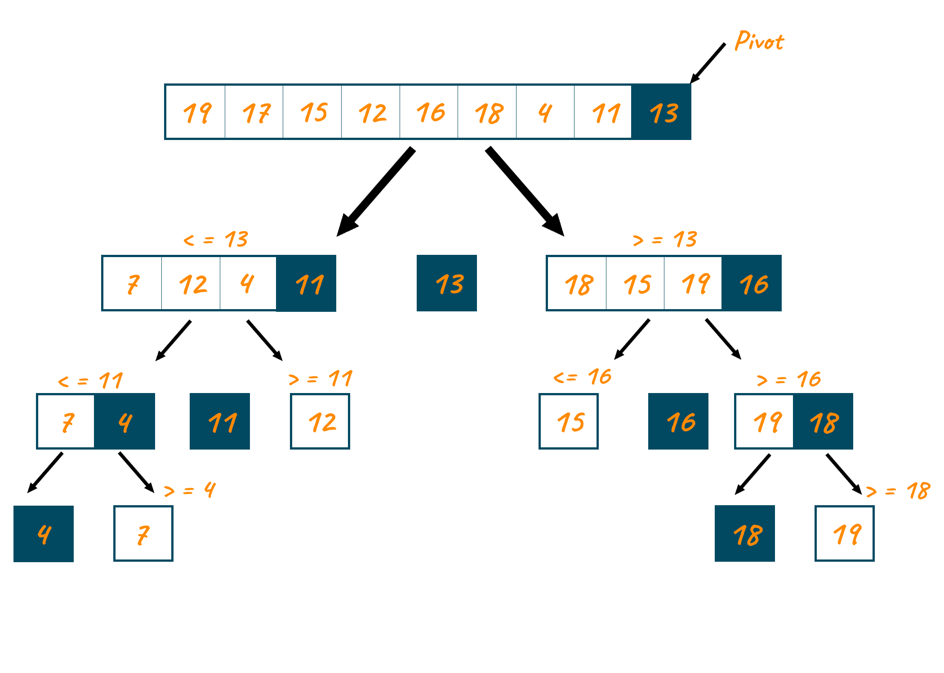

Slide 28
Time Complexity
Case | Time Complexity
Best Case | O(n*logn)
Average Case | O(n*logn)
Worst Case | O(n²)
Space Complexity
Space Complexity | O(n*logn)
Stable | NO

Slide 29
int partition (int a[], int start, int end)
{
int pivot = a[end]; // pivot element
int i = (start - 1);
for (int j = start; j <= end - 1; j++)
{
// If current element is smaller than the pivot
if (a[j] < pivot)
{
i++; // increment index of smaller element
int t = a[i];
a[i] = a[j];
a[j] = t;
}
}
int t = a[i+1];
a[i+1] = a[end];
a[end] = t;
return (i + 1);
}

Slide 30
function to implement quick sort */
void quick(int a[], int start, int end) /* a[] = array to be sorted, start = Starting index, end = Ending index */
{
if (start < end)
{
int p = partition(a, start, end); //p is the partitioning index
quick(a, start, p - 1);
quick(a, p + 1, end);
}
}

Slide 31
/* function to print an array */
void printArr(int a[], int n)
{
int i;
for (i = 0; i < n; i++)
cout<<a[i]<< " ";
}
int main()
{
int a[] = { 23, 8, 28, 13, 18, 26 };
int n = sizeof(a) / sizeof(a[0]);
cout<<"Before sorting array elements are - \n";
printArr(a, n);
quick(a, 0, n - 1);
cout<<"\nAfter sorting array elements are - \n";
printArr(a, n);
return 0;
}

